Slide 1
Java
Objects and Classes
A BPI Training Program

Slide 2
Java
Objects and Classes
About Me
James Paolo W. Menguito
Software Engineer - 7YRS
Exist Software Labs, Inc.
Caishen - 3YRS

Slide 3
Java
Objects and Classes
What You’ll Learn
Objects and Classes
Object-Oriented Programming
Advanced Java

Slide 4
Java
Objects and Classes
What we’ll cover today
Objects
Classes
Variables
Constructors
Methods

Slide 5
Java
Objects and Classes
OBJECT
represents real-world entities, data, or concepts in your program
an instance of a class and encapsulates both data and behaviors
core of the OOP paradigm
Example: a class Person and an instance of a Person is me (or you)
*** Explain “instance”

Slide 6
Java
Objects and Classes
OBJECT - Key Details
objects are created based on class definition
each object has the same structure of a class but can have different data
the data pertains to the attributes/fields defined by the class, these represent the state of the object.
methods are functions or behaviors the object can perform or the actions an object can take.

Slide 7

Java
Objects and Classes
Creating an Object

Slide 8
Java
Objects and Classes
CLASSES
serves as a blueprint or a template for creating objects
defines structure and behavior
class name is written using PascalCase
Example: define what a class Person has (name, age, weight, height, move(), speak() )

Slide 9
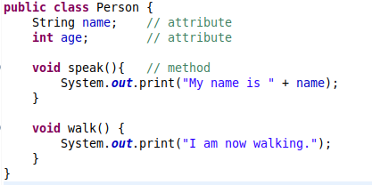
Java
Objects and Classes
Defining a Class

Slide 10
Java
Objects and Classes
Questions?
//

Slide 11



Java
Objects and Classes
Seatwork 1 - Individual
identify at least one attribute and at least one
method for the ff classes

Slide 12
Java
Objects and Classes
Instance Variables
Also known as fields / attributes
Can have a default value based on class definition
Ideally declared as “private” (will dive more into this later)
“What the object knows”

Slide 13
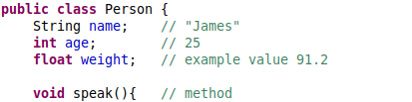
Java
Objects and Classes
Instance Variables - Example 1

Slide 14
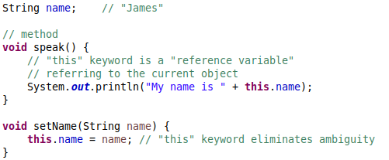
Java
Objects and Classes
Instance Variables - Example 2

Slide 15
Java
Objects and Classes
Constructor
A special method that is called when creating an object (instantiation)
Called in combination with the “new” keyword
Must have the same name as the class
Parameters are optional
No return type
Can be used to initialize instance variables upon object creation

Slide 16
Java
Objects and Classes
Constructor - Example 1
Real world
When you are born, you are given a name are your weight is determined

Slide 17

Java
Objects and Classes
Constructor - Example 2

Slide 18
Java
Objects and Classes
3 Types of Constructors
Default Constructor
No-Argument Constructor
Parameterized Constructor

Slide 19
Java
Objects and Classes
Default Constructor
Created implicitly by Java when no constructor is defined in the class.
Example: Person {} and call new Person()

Slide 20
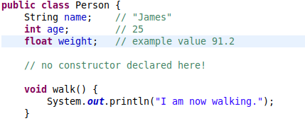

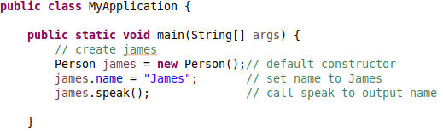
Java
Objects and Classes
Default Constructor

Slide 21
Java
Objects and Classes
No-Argument Constructor
A constructor with no parameters
Used when values are initialized within the class
Example: define Person() {} inside Person class but provide default values for the fields. It doesn’t have to make sense since this is a program.

Slide 22
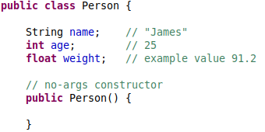
Java
Objects and Classes
No-Argument Constructor

Slide 23
Java
Objects and Classes
Parameterized Constructor
Used to initialize values
Dynamic Values are initialized upon creation.
Example: define Person(String name, float age)

Slide 24
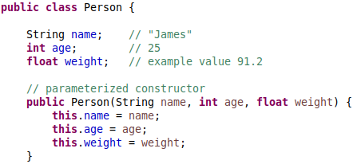
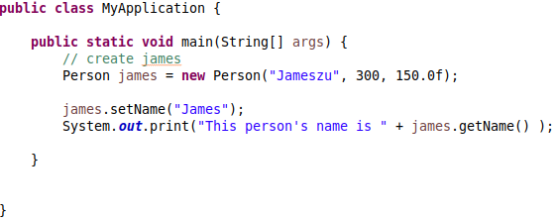
Java
Objects and Classes
Parameterized Constructor

Slide 25
Java
Objects and Classes
METHODS
defines actions or behaviors
encapsulates functionality
a set of statements
can be used to set attributes or get attributes
“things the object does”

Slide 26
Java
Objects and Classes
Declaring Methods / Method Declaration
specify the method's name, the return type, and a list of parameters (optional)
the return type indicates the data type of the value the method can return

Slide 27
Java
Objects and Classes
Method Signature
Refers to the combination of the method name and the parameter list

Slide 28
Java
Objects and Classes
Method Body
the actual logic of the method that is executed when a method is called
contains the block of code enclosed with curly braces

Slide 29
Java
Objects and Classes
Local Variables
A variable declared inside the method body
Only exists within the method and does not belong to the class itself
May serve different purposes such as a temporary holder for a value

Slide 30
Java
Objects and Classes
Method Invocation
use a method by calling it by its name and providing any parameters (if any)
typically done on an object using the “dot” operator (.)

Slide 31
Java
Objects and Classes
Method - Example
Method Example: given a class Person, create a new method for the class Person and provide parameters like String sleep(String placeToSleep, int hours) and return result “Well Rested” or “Still sleepy” based on the hours slept. Demonstrate use of local variables.

Slide 32
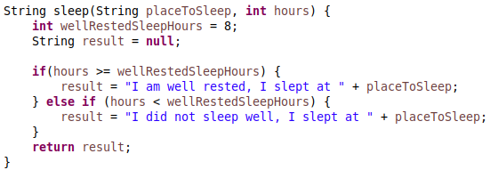
Java
Objects and Classes
Method - Example

Slide 33
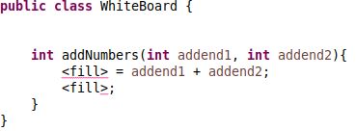

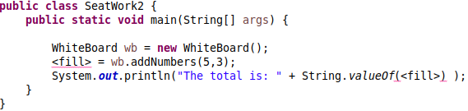
Java
Objects and Classes
Seatwork 2 - Individual
Complete the code snippet below to achieve the output

Slide 34
Java
Objects and Classes
VARIABLES
used to store and manage data
data manipulated by the application

Slide 35
Java
Objects and Classes
Declaring Variables / Variable Declaration
Indicate the data type and declare the name of the variable
Variable names should be typically written in camelCase

Slide 36
Java
Objects and Classes
Initializing Variables
Assign a value to the variable upon declaration
Primitive data types typically have a default value of 0 while objects have a default value of null
Uses the “equal” sign to assign values
Example: int age = 10;

Slide 37
Java
Objects and Classes
Variable Scope
where a variable can be accessed

Slide 38
Java
Objects and Classes
Variable Lifetime
Until when does a variable exist in memory

Slide 39
Java
Objects and Classes
Types of Variables
Local variables
Instance variables
Static Variables (Class variables)

Slide 40
Java
Objects and Classes
Local Variables
Scope: inside a code block such as a constructor or method or other control structures like loops and can only be accessed in that specific code block
Lifetime: exists until the end of the code block or the method execution
Example: mention example above.

Slide 41
Java
Objects and Classes
Instance Variables
Also known as fields / attributes
Scope: declared in a class but outside of methods and can be accessed anywhere within the class
Lifetime: exists as long as the object it belongs to exists in memory
Example: Person’s name, and age

Slide 42
Java
Objects and Classes
Static Variables (Class variables)
Declared using the keyword “static” inside the class but outside of methods
Scope: Belongs to the class itself and only one value is accessible by class
Lifetime: exists as long as the class is loaded in memory
Example: Person class and static field race = HUMAN

Slide 43
Java
Objects and Classes
Static Variables (Class variables)

Slide 44
Java
Objects and Classes
Establishing the use of Getters and Setters
Using the access modifier “private” is best practice for attributes
Getters and Setters are public methods that are used to prevent direct access of the private attributes
Getters and Setters and the use of “private” promotes Object Oriented Programming concepts by enforcing data hiding and controlling data access
This will be discussed further in OOP.

Slide 45
Java
Objects and Classes
Object Identity and References
All objects have a unique identity even if they have the same data
Objects are referred to using References
Multiple references can point to a single object
When an object is created using “new”, memory is allocated on the heap for the object's instance variables

Slide 46
Java
Objects and Classes
Exercise 1 - Individual
Students must create a class Car
Students must add attributes
Students must create at least one method
Students must provide create a Parameterized Constructor
Students must be able to instantiate (create) two cars. One with No Args and One using Parameterized Constructor
Students must be able to assign values to the attributes.
Students must be able to call the method

Slide 47
Java
Objects and Classes
Questions?
//

